Slide 1
Unit V
Research Ethics and Misconduct

Slide 2
Overview
Many engineers are involved in research and development works
Many activities of postgraduate students in universities are also research-oriented
Having the right conduct in research has a direct consequence on the credibility of the research results, and thus the prospects of the engineer and students, as well as the research institutions involved
Research ethics – the study of the ethics for planning, conduct, and reporting of research

Slide 3
Trust-based research world
Most research activities are conducted based on “trust”
If we don’t have “trust” in other people’s research work …
A project supervisor needs to read every program codes developed by his 10 research students, each of them may write 500 lines of codes per day
A research group leader needs to read every publication of his group members since all of them bear the name of the group (can be a hundred per year)
The University President needs to go into the details of every research work of all professors since all of them bear the name of the University (can be thousands of research papers and other research outputs)
If we don’t have trust, the advancement of knowledge and technology will be much slower

Slide 4
Trust-based research world
Why can we trust other people’s research results?
Because we know those researchers follow a set of research ethics that most researchers also follow in the world
It is also the reason why sometimes we can’t trust the research in some parts of the world since we know the researchers there may not follow such a set of research ethic
For this reason, anybody who is found to have breached the trust, in particular due to research misconduct, will usually have very serious penalty
For students – deregistration
For employees – dismissal
For professionals – life disqualified

Slide 5
Research misconduct
Research misconduct covers wrongdoing (usually intentional) related to scientific research
Need to be strictly prohibited since science is predicated on trust
Without confidence in the integrity of their peers, scientists would be unable to trust one another's work
What actually counts as research misconduct? Three main acts:
Fabrication – making up of data or information without going through a scientific experimentation process
Falsification – misrepresenting of data or experiments, i.e., ‘cooking the data’
Plagiarism – presenting the work or ideas of another person as one’s own

Slide 6


Falsification
Falsification is the alternation of the observed result of a scientific experiment
Practice of manipulating research materials, equipment, or processes, or changing or omitting data or results such that the research is not accurately represented in the research record
More commonly with the intention of improving the results or removing results that do not fit the hypothesis
Falsification
Hypothesis
Experiment
Negative results
Positive results
Publish

Slide 7
Falsification
Common practices of falsification
Remove the bad results in the experiment and report only the good results
Build an experiment environment that favors the proposed idea
Adjust the working condition of the testing equipment to let them give positive testing results
Tailor the survey group to ensure the survey results favor the hypothesis
The above are all considered research misconduct if the details of the falsification practice are not reported

Slide 8
Plagiarism
Plagiarism is defined as using other people’s work and/or other sources without giving proper acknowledgment of the sources
Plagiarism also occurs when Generative AI output is used when it is explicitly disallowed
Sometimes it is not only an ethical issue but also a violation of law (such as copyright law)
Plagiarism is not only limited to using other people’s work. Self-plagiarism (plagiarizing oneself) sometimes is also not allowed
For some professional bodies (such as some IEEE societies), a paper that has been published at a conference cannot be published again in a journal if it describes the same piece of work

Slide 9
Plagiarism
Citation is the key to avoid plagiarism
When to cite?
For any idea not originated by you
How to cite?
https://libguides.lb.polyu.edu.hk/academic-integrity/citation
When no need to cite?
You are discussing your own ideas, findings, or experimental results
Well-known facts or common knowledge – Mothers are women (if you are not sure whether it is a well-known fact, just cite it!)

Slide 10
Trend of research misconduct
How frequently does research misconduct occur?
There are many barriers to accurately quantifying the extent of research misconduct
Cases may go unreported and institutions may be biased against finding misconduct
It is particularly the case in some countries where research achievement can significantly affect the income of the researchers
Paper retraction rate is often used as an indirect indicator of the magnitude of research misconduct
Refer to the ratio of the number of papers required to be retracted after publication and the total number of published papers
Retraction may be initiated by the journal owing to misconduct found in the paper, or just an honest mistake, such as authors identifying errors in their own work
Besides, there are undiscovered misconduct cases that do not result in paper retraction
That is why the number can only give a rough idea of the actual misconduct situation

Slide 11
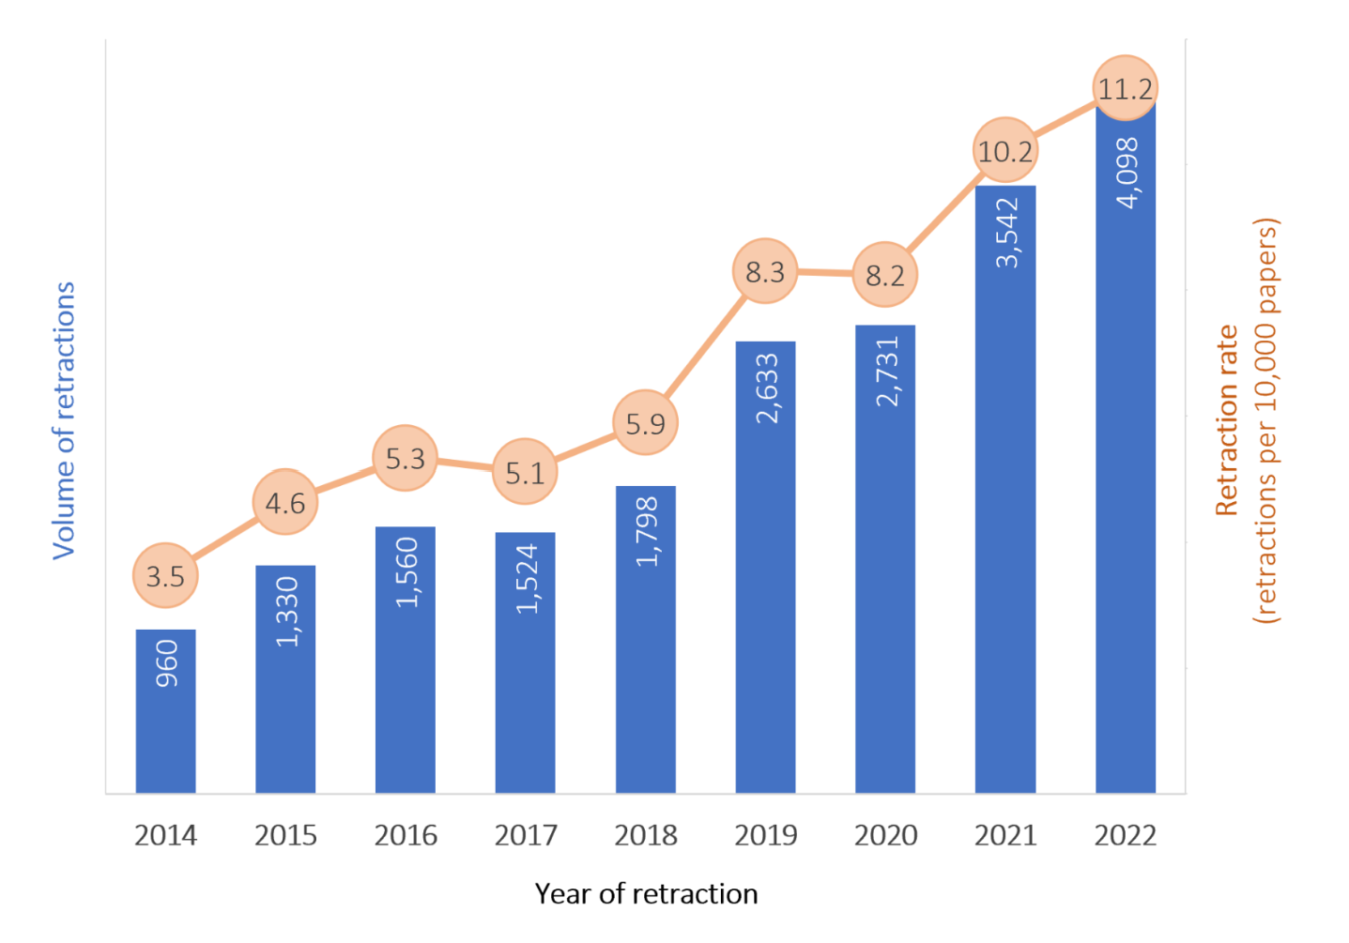
Trend of research misconduct
Statistics show that there was a tremendous growth in the paper retraction rate since 2019
According to a report from Nature in 2021^{[1]}, thousands of retracted papers can be traced to paper mills from several countries, including China
In research, a paper mill is a business that publishes poor or fake journal papers that seem to resemble genuine research, as well as sells authorship
Paper mill companies are not difficult to find
E.g., in 2022, Science covered a report exposing a Russian paper mill company^{[2]}
The report identified hundreds of published academic papers where positions for authorship had been sold through a Russian website
Retraction rate and Volume of retraction from 2014 to 2022
https://scholarlykitchen.sspnet.org/2024/04/18/guest-post-making-sense-of-retractions-and-tackling-research-misconduct/
[1] Else, Holly; Van Noorden, Richard (2021-03-23). "The fight against fake-paper factories that churn out sham science". Nature. 591 (7851): 516–519
[2] Chawla, Dalmeet (2022-04-06). "Russian site peddles paper authorship in reputable journals for up to $5000 a pop". www.science.org

Slide 12
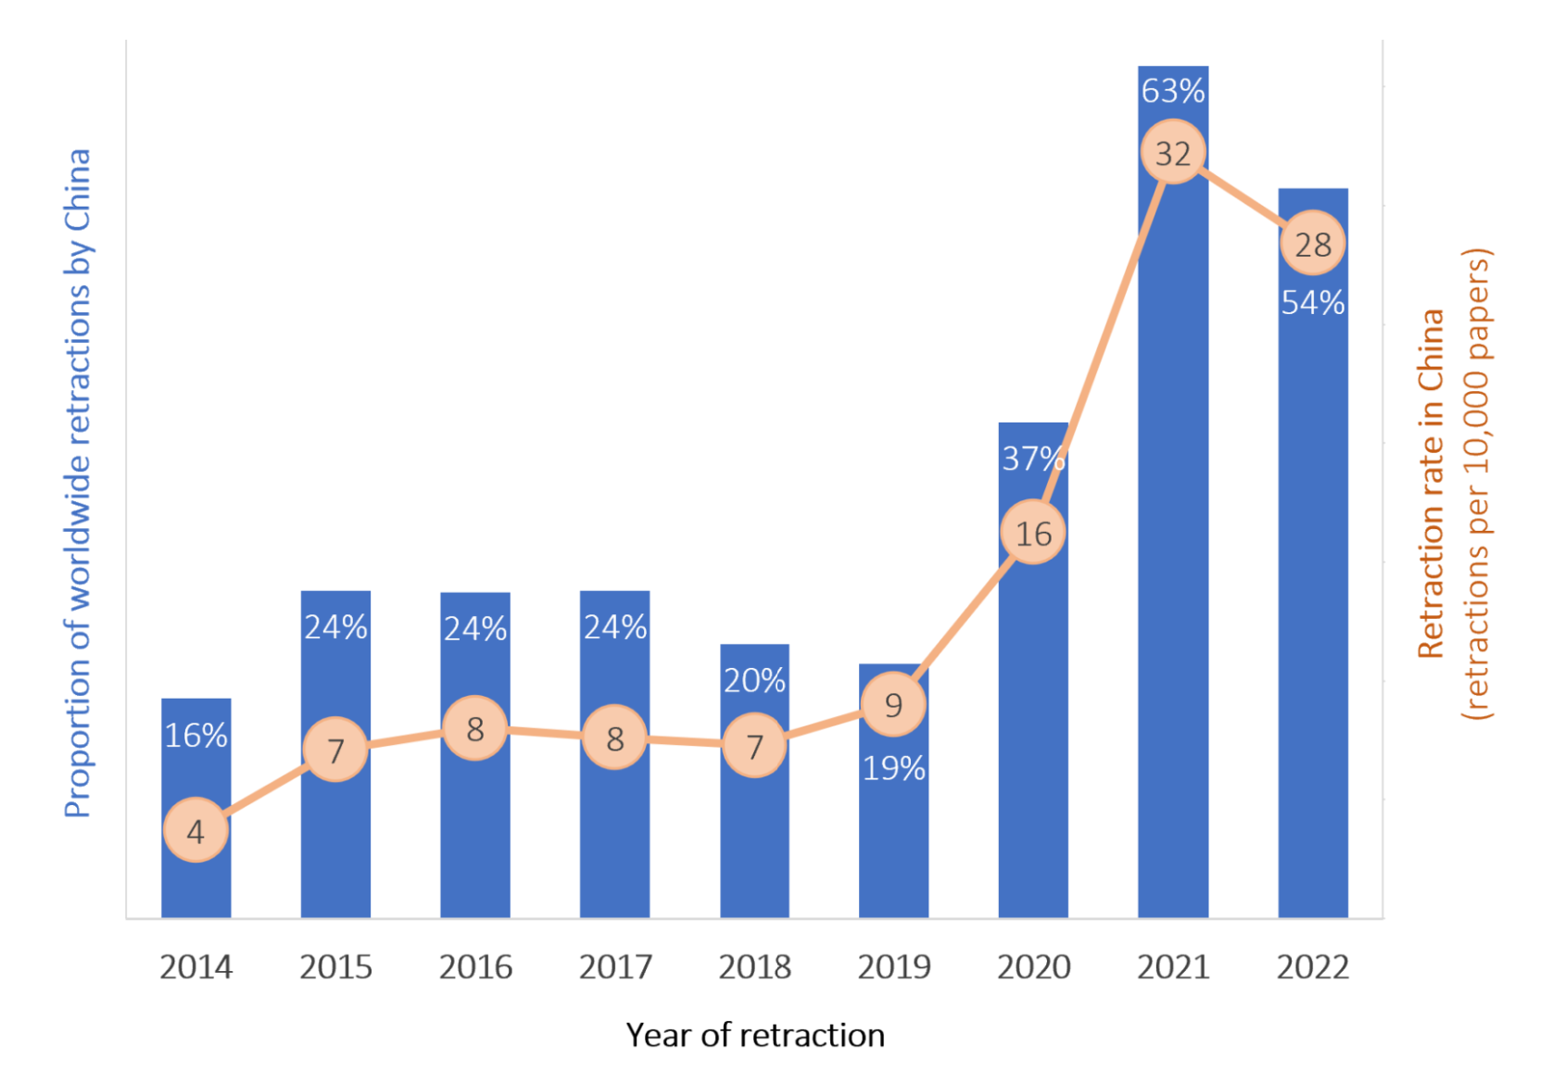
Research misconduct in China
In the period from 2020 to 2022, China’s paper retraction rate is dramatic, reaching 26.1 retractions per 10,000 papers, compared to 5.9 for the rest of the world
Nature revealed that there were almost 17,000 retraction notices on papers with China-affiliated authors since January 2021^{[1]}
Report reveals that Chinese researchers are prevalent customers of paper mill services, particularly in the biomedicine and life science areas^{[1]}
Hindawi, a subsidiary of Wiley, retracted over 8000 articles involving Chinese co-authors in 2023, a record-breaking year for retractions that resulted in Wiley announcing that it would stop using the Hindawi brand
Retraction rate in China and
Proportion of worldwide retraction by China
from 2014 to 2022
https://scholarlykitchen.sspnet.org/2024/04/18/guest-post-making-sense-of-retractions-and-tackling-research-misconduct/
[1] Else, Holly; Van Noorden, Richard (2021-03-23). "The fight against fake-paper factories that churn out sham science". Nature. 591 (7851): 516–519

Slide 13
Avoiding research misconduct
Measures have been put forward by different stakeholders in recent years to avoid research misconduct
A growing number of service providers, publishers, and startups have come up with technological solutions to combat misconduct at the point of journal submission. E.g.,
Wiley is developing an AI-powered papermill detection service
The STM Research Integrity Hub has brought together dozens of publishers and offers a holistic approach to detect offending manuscripts

Slide 14
Avoiding research misconduct
New policies were put out in some countries to discourage research misconduct
E.g., in 2024, China Ministry of Education issues a notice indicating that:
Universities must declare all their retractions and launch investigations into misconduct cases
Researchers with retracted papers will have to explain whether the retraction was owing to misconduct, or just an honest mistake
The notice states explicitly that the first corresponding author of a paper is responsible for submitting the response. This requirement largely addresses the problem of researchers shirking responsibility for collaborative work
If a researcher fails to declare their retracted paper and it is later uncovered, they will be punished
Possible punishments may include salary cuts, withdrawal of bonuses, demotions, and timed suspensions from applying for research grants and rewards, as what China’s National Health Commission did in 2021

Slide 15
Avoiding research misconduct
Universities also provide education programs for research personnel to understand the importance of research ethics
For example, PolyU has subscribed to the Collaborative Institutional Training Initiative (CITI) Program since 2023 December
The CITI Program is an online platform offering comprehensive training in research ethics and compliance, which can enhance students’ professional profile and demonstrate their dedication to the highest standards in research and compliance
With this subscription, all PolyU students and staff can access the following courses:
Animal Care and Use
Compensation Reporting (Effort Reporting)
Conflicts of Interest
Export Compliance
False Claims Act: A Primer and Guide for
Research Organizations
GDPR for Research and Higher Ed
Good Clinical Practice
Human Subjects Research: Biomedical and
Social/Behavioral (plus Revised Common Rule)
Information Privacy and Security
Responsible Conduct of Research
Technology Transfer
Undue Foreign Influence: Risks and Mitigations
https://www.citiprogram.org/.

Slide 16
Research misconduct – Lifelong black mark
All research misconduct behaviors are due to dishonesty
Similar to many dishonest cases, the research personnel involved usually just wants to tell a small lie at the beginning, making benefit of the trusting nature of the research world
If it goes unnoticed, the research personnel often needs to tell a bigger lie to cover up the first lie in order to sustain his/her career, leading to bigger and bigger lies and pressure on the research personnel
Most research misconduct behaviors will lead to black-and-white records
Plagiarized theses, falsified papers, fake designs, etc.
They become lifelong black marks that can be easily utilized by the enemies to attack the research personnel at the time he/she becomes important

Slide 17
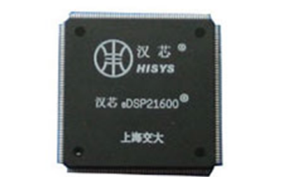
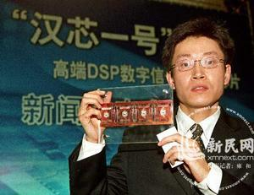
Case study: Hanxin-I
Hanxin has ever been considered the biggest technological breakthrough in the microchip industry in China
Claimed as the first China-designed and made digital signal processing computer chip
However, it was all a fraud confirmed by the Chinese government after a detailed investigation^{[1]}
Hanxin-I
The announcement of Hanxin-I at a news conference
[1] https://baike.baidu.com/item/%E6%B1%89%E8%8A%AF%E4%BA%8B%E4%BB%B6/3675593

Slide 18
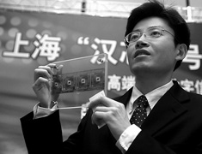
Case study: Background
In the early 2000s, there was enormous pressure in China to design and produce its own integrated circuit chips
China was spending billions of dollars buying foreign-made chips to put in electronics equipment. So the government has made it a major priority
Chen Jin, a top computer scientist, was involved in the scandal
Chen earned a bachelor’s degree at Shanghai Tongji University in 1991. Then, he moved to the United states to study computer engineering at the University of Texas at Austin
In 1998, he got a Ph.D. there and worked at Motorola Research Center as an engineer responsible for chip testing (however, he claimed himself a senior design manager in that company)
Chen Jin announcing Hanxin-I
http://www.china.org.cn/english/scitech/168482.htm

Slide 19
Case study: The beginning …
After getting back to China, Chen formed his team at Shanghai Jiaotong University in 2001
Within two years, Chen announced that he created a digital signal processor with the capability of processing 200 million instructions per second
It astonished the whole chip manufacturing industry. For a newly formed team, developing a chip from design to manufacturing in two years was just too fast
The DSP can process the digitized data for mobile phones, cameras, and other electronic devices
In the announcement news conference, Chen Jin demonstrated the capability of the chip to play MP3 and perform fingerprint recognition
Hanxin chips were officially recognized as reaching the international high-end microprocessor chip standard

Slide 20
Case study: The beginning …
Chen was named as the Dean of the microelectronics school of Shanghai Jiaotong University.
He headed his own university research institute and a few companies, all of them were heavily financed by the government
He was named a Chang Jiang Scholar, a title with privileges given to a select group of China's best young scholars, by Beijing. At that time, he was only 35
With the financial support of the government, Chen announced in 2004 the creation of the even faster Hanxin-II and-III
The total research funding obtained from the government was up to a Billion RMB

Slide 21
Case study: The downfall …
In December 2005, a whistleblower posted a message on an Internet bulletin board of the Tsinghua University
The message, and letters to the government and the university, led to an avalanche of scrutiny and bad publicity
The whistleblowers also gave details of an array of companies that Chen operated to profit from the big government contracts
They triggered the government to form an investigation panel to understand if the allegation was true
After about 3 months of investigation, the panel concluded that there existed serious forgery and dishonest behavior in the case for obtaining huge financial support from the government

Slide 22
Case study: The fact …
The Hanxin-I chip that Chen developed was simply purchased from a foreign company and with the logo sandpapered
Its structure is rather simple and does not have the capability of playing MP3 or fingerprint recognition on its own as demonstrated in the announcement news conference
The demo made in the announcement was done by a Motorola DSP chip purchased on the market
Surprisingly, the chip used in the demo has 144 pins but the one developed by Chen has 208 pins. But no one noticed that in the demo
Hanxin-II and III were really developed by Chen’s team but Chen did not have the IP of their core technology. Besides, they also could not perform complex tasks like playing MP3 or performing fingerprint recognition on their own
Chen was not working as Senior Chip Design Manager in Motorola US. He was just a testing engineer with no experience in chip design

Slide 23
Case study: The consequence …
Chen Jin was fired from the Shanghai Jiaotong University and stripped of his state honors and privilege
He was also banned from conducting further state-funded research
He was also required to return all research funding obtained from the government
However, there was no mention of any relevant responsible persons were subject to legal prosecution
The news was soon spread out all over the world. China became a laughing stock for allowing such an event to happen
Also seriously jeopardize the reputation of Shanghai Jiaotong University

Slide 24
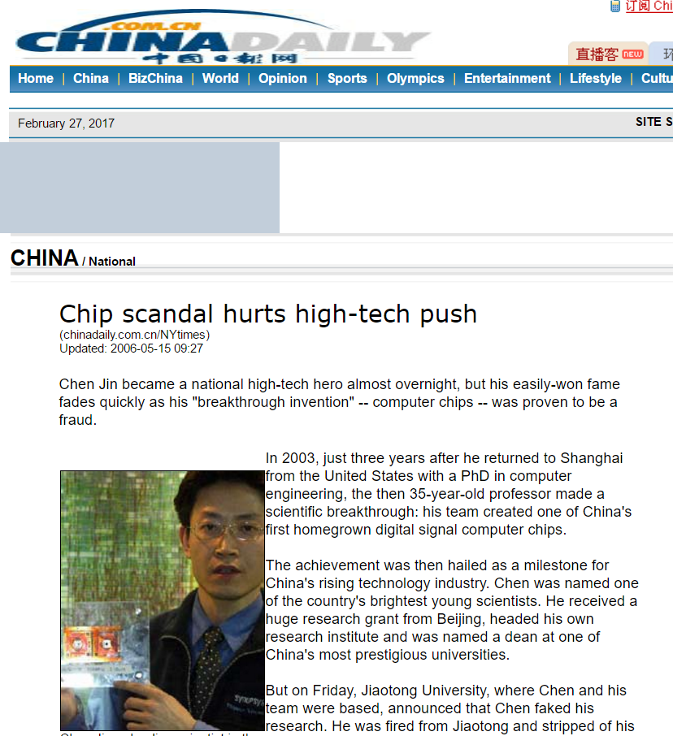
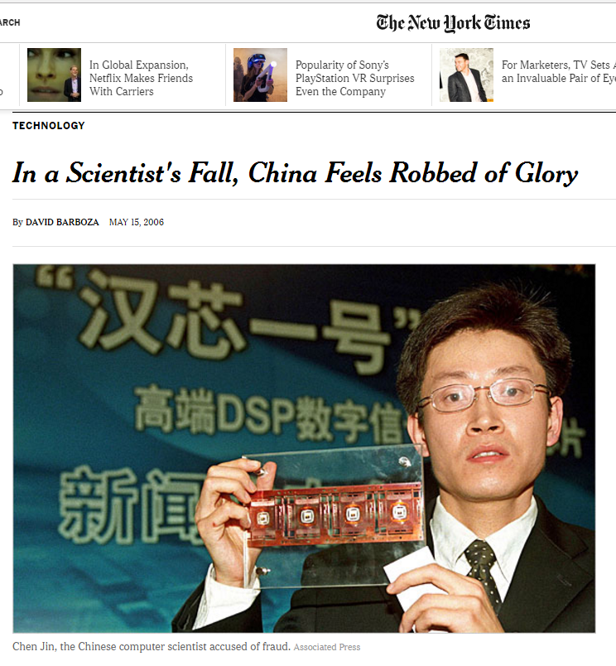
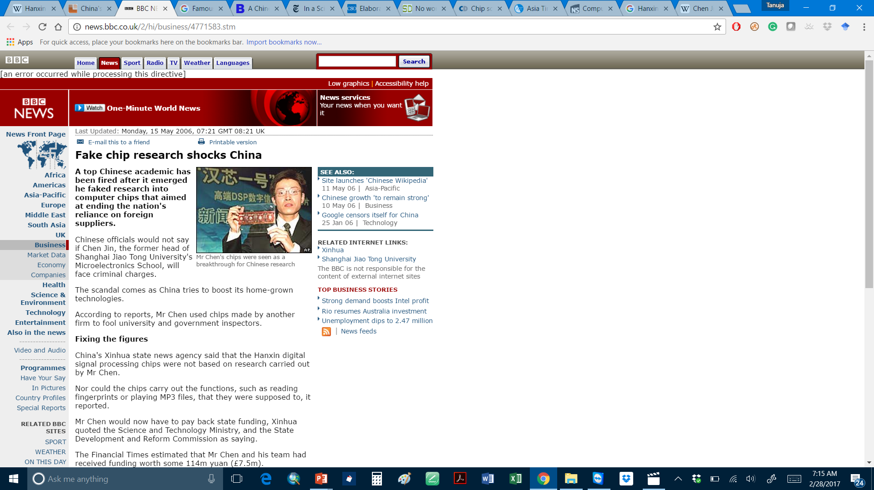
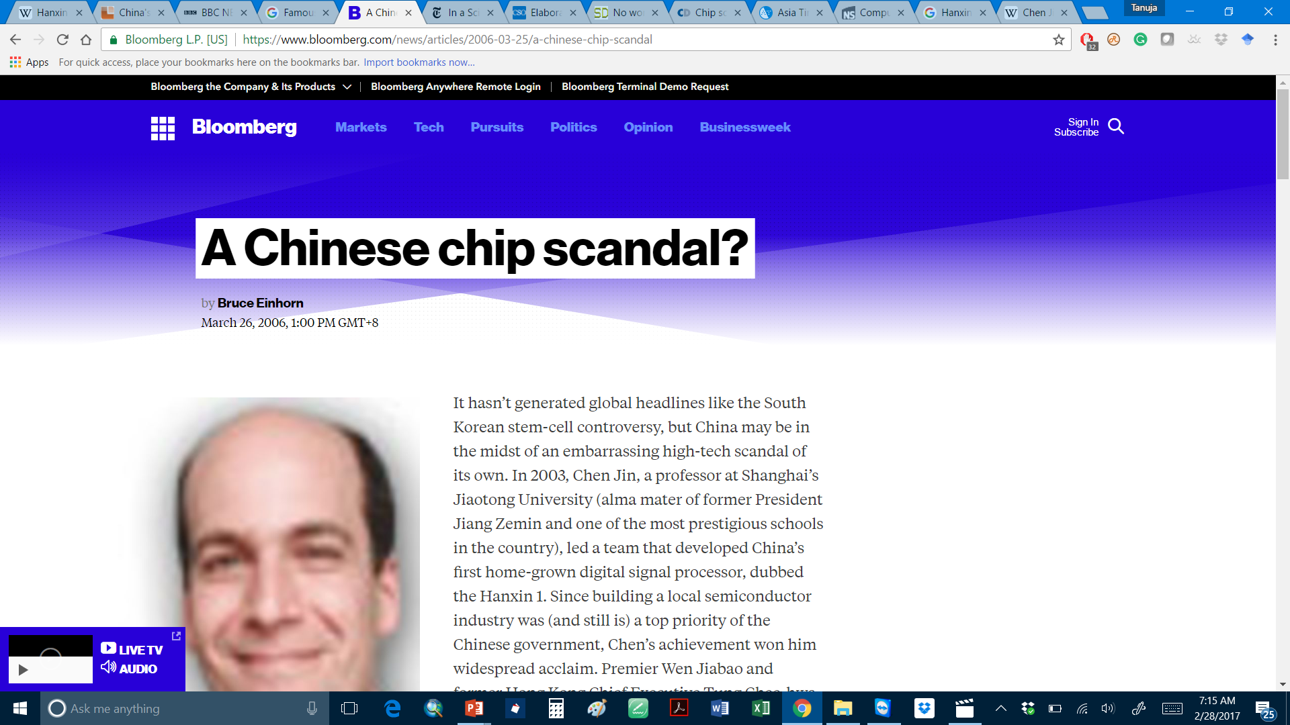
Hanxin-1 Scandal

Slide 25
Case study: Far-reaching effect
Impacted by the scandal, the indigenous innovation in China’s IC sector was questioned and many projects were suspended
The government’s financial and policy support was severely reduced accordingly
The country became more reliant on the chips imported from the US, Taiwan, Japan, South Korea, etc.
The situation continued until 2014 when the National Integrated Circuit Industry Investment Fund was established and the release of the Outline of the Program for National Integrated Circuit Industry Development by the State Council
Due to the scandal, the country lagged behind other competitors for nearly 10 years in IC design. This led to great difficulty for the electronic industry particularly when President Trump forbade the US IC design technologies from importing China in 2019
https://www.jstor.org/stable/resrep31646.9?seq=4

Slide 26
Summary
Scientific research is based on trust or the advancement of knowledge and technology will be much slower
Anyone who is found to breach the trust particularly due to research misconduct will be seriously punished
Three main acts of research misconduct: fabrication, falsification, and plagiarism
Different stakeholders have put forward measures in recent years to avoid research misconduct
Anyone who practices research misconduct will leave a lifelong black mark
Research misconduct of individuals may not only affect oneself but can have a far-reaching effect

